Slide 1
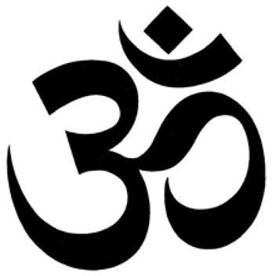
Meditation

Slide 2
What is Meditation?
Meditation is a mind-body practice in complementary and alternative medicine (CAM). There are many types of meditation, most of which originated in ancient religious and spiritual traditions. Generally, a person who is meditating uses certain techniques, such as a specific posture, focused attention, and an open attitude toward distractions. Meditation may be practiced for many reasons, such as to increase calmness and physical relaxation, to improve psychological balance, to cope with illness, or to enhance overall health and well-being.

Slide 3
Techniques
The term meditation refers to a group of techniques, such as mantra meditation, relaxation response, mindfulness meditation, and Zen Buddhist meditation. Most meditative techniques started in Eastern religious or spiritual traditions. These techniques have been used by many different cultures throughout the world for thousands of years. Today, many people use meditation outside of its traditional religious or cultural settings, for health and well-being.

Slide 4
Mindfulness
In meditation, a person learns to focus attention. Some forms of meditation instruct the practitioner to become mindful of thoughts, feelings, and sensations and to observe them in a nonjudgmental way. This practice is believed to result in a state of greater calmness and physical relaxation, and psychological balance. Practicing meditation can change how a person relates to the flow of emotions and thoughts.

Slide 5
Most types of meditation have four elements in common:
A quiet location. Meditation is usually practiced in a quiet place with as few distractions as possible. This can be particularly helpful for beginners.
A specific, comfortable posture. Depending on the type being practiced, meditation can be done while sitting, lying down, standing, walking, or in other positions.
A focus of attention. Focusing one's attention is usually a part of meditation. For example, the meditator may focus on a mantra (a specially chosen word or set of words), an object, or the sensations of the breath. Some forms of meditation involve paying attention to whatever is the dominant content of consciousness.
An open attitude. Having an open attitude during meditation means letting distractions come and go naturally without judging them. When the attention goes to distracting or wandering thoughts, they are not suppressed; instead, the meditator gently brings attention back to the focus. In some types of meditation, the meditator learns to "observe" thoughts and emotions while meditating.

Slide 6
Guided Meditation
http://www.youtube.com/watch?v=VVNx_NwMMQk
http://www.youtube.com/watch?v=uVZaDIDambg

